Slide 1
Respect Life

Slide 2
We are beautifully and wonderfully made.
Each and every human life is
a gift from God
to be celebrated and protected.
Notes:
Life: Imagine the Potential, Spot 3 – 45 seconds
http://www.youtube.com/watch?v=kxH7CUhHkug&feature=player_embedded

Slide 3
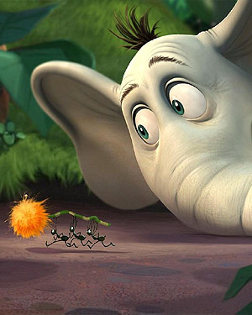
“A person’s
a person,
no matter
how small.”
- Dr. Seuss
Notes:
Basic fetal development facts
From the moment of conception, all 46 chromosomes are present, gender is determined, and a new unrepeatable human being comes into the world.
During the first month, the baby grows to 10,000 times his size at conception.
By the third week, the heart begins to beat.
Brain waves can be recorded in the second month. Teeth form and fingers and toes begin developing.
By eight weeks, all body systems are present.
In the third month, fingernails and toenails form and the baby has a unique fingerprint.
In the fourth month, facial expressions can be seen and babies dream.
At five months, some babies are viable, meaning they can survive outside the womb.
During the 6th month, babies respond to sound.
At seven months, babies can hear, taste, cough, yawn, and hiccup.
Through the 8th and 9th months, babies continue to gain weight and prepare for birth.
Watch Me Grow, Little One Sweet Publishing (2004).

Slide 4
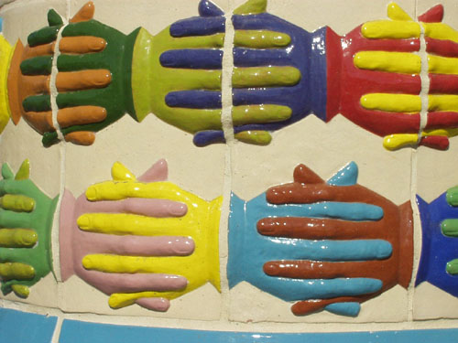
Persons are infinitely valuable
as well, despite their age,
infirmity, guilt, or disability.
Notes:
“The elderly are not only to be considered the object of our concern, closeness and service. They themselves have a valuable contribution to make to the Gospel of Life. Thanks to the rich treasury of experiences they have acquired through the years, the elderly can and must be sources of wisdom and witnesses of hope and love.” Gospel of Life n. 94.
Think of your grandparents or older people in your life. Do you know anyone with a disability or illness? Do you love them any less because of their age or disability? Do you think God does? What have you learned from them? Do you think helping others brings out something good in yourself – something you might not have shared without the person who needed your help?

Slide 5
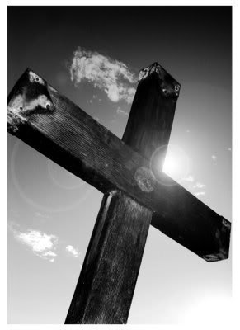
We are impassioned,
inspired, and energized
by the love of Christ.
Notes:
Questions
Have you ever met someone who had something about them (joy, hope, strength, wisdom, peace) that you craved?
Who are these people in your life?
What inspires them? What gives them this joy, hope, strength, etc?

Slide 6
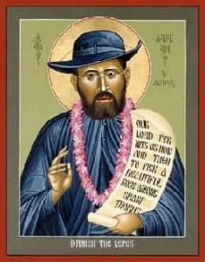
Fr. Damien was inspired
by the love of Christ.
When he looked at a leper,
he saw a human being,
not leprosity, infirmity,
criminal history, handicap,
old age, or infancy.
Notes:
“It is impossible to further the common good without acknowledging and defending the right to life, upon which the other inalienable rights of individuals are founded and from which they develop.” Gospel of Life n. 101.
He saw human life -- not leprosy, infirmity, criminal history, handicap, age, infancy, etc.
He will be canonized October 11, 2009.
Biography: (from Catholic Encyclopedia, available at http://www.newadvent.org/cathen/04615a.htm)
Missionary priest, born at Tremeloo, Belgium, 3 January 1840; died at Molokai, Hawaii, 15 April 1889.
His father, a small farmer, sent him to a college at Braine-le-Comte, to prepare for a commercial profession; but as a result of a mission given by the Redemptorists in 1858, Joseph decided to become a religious. He entered the novitiate of the Fathers of the Sacred Heart of Jesus and Mary at Louvain, and took in religion the name of Damien. He was admitted to the religious profession, 7 Oct. 1860. Three years later, though still in minor orders, he was sent to the mission of the Hawaiian Islands, where he arrived, 19 March, 1864. Ordained priest at Honolulu 24 May of the same year, he was later given charge of various districts on the island of Hawaii, and, animated with a burning zeal, his robust constitution allowed him to give full play to the impulses of his heart. He was not only the missionary of the natives, but also constructed several chapels with his own hands, both in Hawaii and in Molokai.
On the latter island there had grown up a leper settlement where the Government kept segregated all persons afflicted with the loathsome disease. The board of health supplied the unfortunates with food and clothing, but was unable in the beginning to provide them with either resident physicians or nurses. On 10 May, 1873, Father Damien, at his own request and with the sanction of his bishop, arrived at the settlement as its resident priest. There were then 600 lepers. "As long as the lepers can care for themselves", wrote the superintendent of the board of health to Bishop Maigret, "they are comparatively comfortable, but as soon as the dreadful disease renders them helpless, it would seem that even demons themselves would pity their condition and hasten their death." For a long time, however, Father Damien was the only one to bring them the succour they so greatly needed. He not only administered the consolations of religion, but also rendered them such little medical service and bodily comforts as were within his power. He dressed their ulcers, helped them erect their cottages, and went so far as to dig their graves and make their coffins. After twelve years of this heroic service he discovered in himself the first symptoms of the disease. This was in 1885. He nevertheless continued his charitable ministrations, being assisted at this period by two other priests and two lay brothers. On 28 March, 1889, Father Damien became helpless and passed away shortly after, closing his fifteenth year in the service of the lepers.
Certain utterances concerning his morality called forth Robert Louis Stevenson's well-known philippic against the Rev. Dr. Hyde, wherein the memory of the Apostle of the Lepers is brilliantly vindicated. In addition a correspondence in the "Pacific Commercial Advertiser", 20 June, 1905, completely removes from the character of Father Damien every vestige of suspicion, proving beyond a doubt that Dr. Hyde's insinuations rested merely on misunderstandings.
Long before he had the disease, he spoke of himself and the people of Molokai as "we lepers." Six months after his arrival at Kalawao he wrote his brother in Europe: "...I make myself a leper with the lepers to gain all to Jesus Christ. That is why, in preaching, I say ‘we lepers’; not, ‘my brethren....’"
8 minute video available online: http://www.pbs.org/wnet/religionandethics/episodes/january-23-2009/father-damiens-legacy/2030/

Slide 7
31 year old African American world famous brain surgeon,
single, no kids
40 year old Hispanic male teacher, 2 kids
50 year old homeless woman
62 year old Jewish doctor on staff at your hospital,
a respected colleague, 3 grown children, 8 grandchildren
10 year old quadriplegic girl, alert and oriented
15 year old pregnant girl, high school student
67 year old President of the United States
21 year old waitress helping to support her family,
has no insurance, high school dropout
72 year old gay Chinese research scientist,
on the verge of finding a cure for AIDS, no family
newborn with congenital heart disease
26 year old woman incarcerated for attempted murder
your best friend
Who?
Notes:
Each and every person has unique gifts and talents.
The objective of this assignment is to help students realize the biases involved in humans choosing who lives and dies and to highlight the important gifts that each and every person has to offer the world.
A hospital has been notified that a human heart is available for transplant. Each patient on the list is in immediate need of a heart and in danger of dying within days. Imagine that you are on the board of health care professionals that decides who gets the heart. Assuming all the following patients are medically qualified and a “match,” whom do you choose and what criteria do you use to make your decision?
The patients are:
SEE SLIDE
Ask students to consider the options, brainstorm all possible social, religious, ethnic, financial, etc factors they would use as a basis for the decision, choose the patient they would give the heart to, and determine the basis for their decision. If they would like to, invite students to share their choices and their reasons.
The instructor then suggests to the students the dangers of choosing one person’s life over another and wrestling with prejudices and “quality of life” judgments.

Slide 8
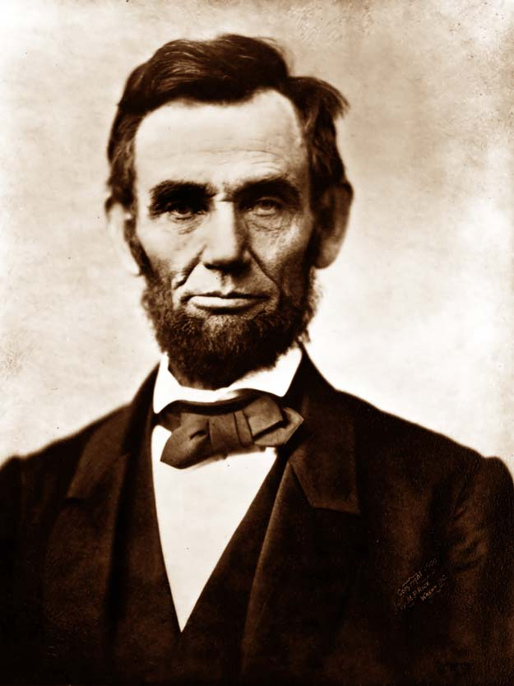
“ You say A. is white, and B. is black.
Notes:
Reiterate essential lessons
We are created in the image and likeness of God. This holds true when we are in our mothers’ wombs, as we approach death, and all the time in between.
Life is a gift.
We are to live it to its fullest and help others to do the same.

Slide 9
“ You say A. is white, and B. is black.
It is color, then; the lighter,
having the right to enslave the darker?
Take care.
By this rule, you are to
be slave to the first man you meet,
with a fairer skin than your own.

Slide 10
You do not mean color exactly?
You mean the whites are intellectually
the superiors of the blacks,
and, therefore
have the right to enslave them?
Take care again.
By this rule, you are to
be slave to the first man you meet,
with an intellect superior to your own.

Slide 11
But, say you, it is a question of interest;
and, if you can make it your interest,
you have the right to enslave another.
Very well.
And if he can make it his interest,
he has the right to enslave you

Slide 12

What can
we do?
Notes:
Ask students to brainstorm individually ideas of how they can create a culture of life, reaffirming the dignity and value of each and every human life from womb to tomb. Suggest that they list small things like wearing a precious feet pin on their backpacks to large things like taking a summer internship at a pro-life organization. Invite students to share their ideas with the group. Hand out the list of ways to create a culture of life attached. Invite students to reflect for a few quiet moments on 2-3 things from that list or their own list that they can commit to doing to build a culture of life. If you would like, record the shared student responses and email the list to participating students later.

Slide 13

Questions

