Slide 1
A Window to the Womb
Fetal Development
& the Development of Sonography

Slide 2

Before I formed you in the womb I knew you, before you were born I dedicated you, a prophet to the nations I appointed you.
Jeremiah 1:5

Slide 3

Fetal Development
By the third week (before most women even know they are pregnant, the heart begins to beat.
  By eight weeks, all body systems are present.
  In the third month, fingernails and toenails form.
Notes:
From the moment of conception, all 46 chromosomes are present, gender is determined, and a new unrepeatable human being comes into the world.
During the first month, the baby grows to 10,000 times his size at conception.
By the third week, the heart begins to beat.
Brain waves can be recorded in the second month. Teeth form and fingers and toes begin developing.
By eight weeks, all body systems are present.
In the third month, fingernails and toenails form and the baby has a unique fingerprint.
In the fourth month, facial expressions can be seen and babies dream.
At five months, some babies are viable, meaning they can survive outside the womb.
During the 6th month, babies respond to sound.
At seven months, babies can hear, taste, cough, yawn, and hiccup.
Through the 8th and 9th months, babies continue to gain weight and prepare for birth.

Slide 4
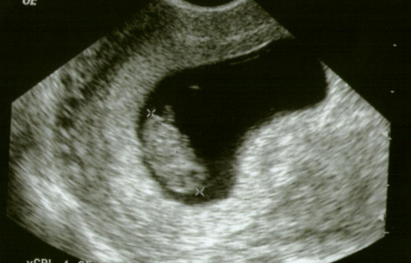
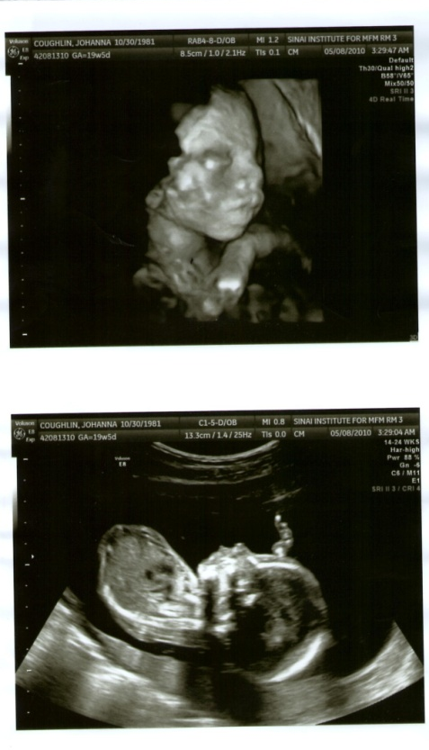
Sonography
so·nog·ra·phy:
Pronunciation: /sō-näg-rə-fē/
Physics. sound with a frequency greater than 20,000 Hz, approximately the upper limit of human hearing.
Medicine/Medical. the application of ultrasonic waves to therapy or diagnostics, as in deep-heat treatment of a joint or imaging of internal structures.
Notes:
Many believe this is the future of the pro-life movement. These pictures provide visual proof of the humanity of the unborn.
Ultrasonography: The location, measurement, or delineation of deep structures by measuring the reflection or transmission of high frequency or ultrasonic waves. Computer calculation of the distance to the sound-reflecting or absorbing surface plus the known orientation of the sound beam gives a two-dimensional image.
It is important to understand that sonologists around the world have always conjured three-dimensional images of anatomy or pathology in their minds while doing their 2D scans. However, until recently it was not possible to do this type of reconstruction on patient data acquired using ultrasound. The advent of 3D and 4D ultrasound for the first time allowed us a peek into the mechanics of thinking of a sonologist by acquiring the volume data and allowing us to reconstruct the images in different planes on the ultrasound machine or a workstation. The problem is that we are not used to manipulating this data in such an “external” visualization format. It takes some understanding of the basics of volume acquisition and manipulation to understand the dynamics of reconstruction. It is perhaps easier for radiologists who have dealt with axial imaging in CT and multiplanar imaging in MRI since they are used to sectional imaging. Additionally the ability to render the volume using different algorithms makes it seem more complicated. However, the basic steps are simple, and a logical approach to 3D and 4D scanning can help in its complete comprehension, and even makes it easier to scan in many instances. Remember, multiplanar imaging is the greatest benefit of Volume scans. (from GE Healthcare, http://www.gehealthcare.com/usen/ultrasound/education/products/cme_3d4d.html)

Slide 5

Eyewitness 2: The Next Generation
"A picture is worth a thousand words.”

Slide 6
From the moment of fertilization each embryo is a distinct, living, and whole human being. This is scientific fact.
Abortion and embryonic stem cell research take the life of human beings in their embryonic or fetal stages.

