Slide 1
Defending the Truth
A Lesson in Pro Life Apologetics

Slide 2
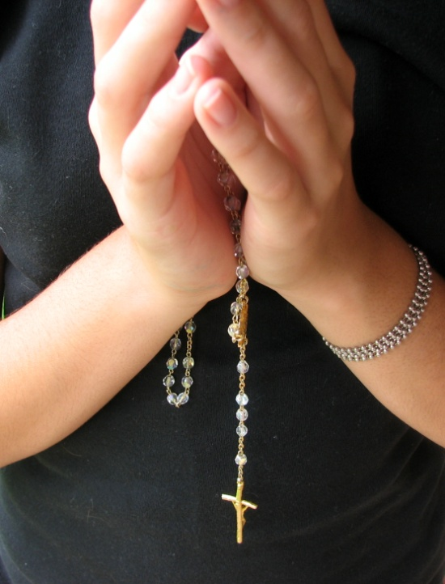
Pray
Know your audience
Know your facts
Your peers and your community may also suffer post-abortion grief, struggle with end-of-life issues regarding a relative or friend, or be in a crisis pregnancy.
Over 1 million abortions are performed each year in the United States.
    From the moment of conception, there is a distinct, living and whole human being.
    The preborn human heart is beating by the third week.
    Abortion hurts women, children, and families.
Notes:
Pray
Invite the Holy Spirit to speak through you.
Pray for the wisdom to most effectively build the culture of life and love your neighbor.
We are most effective when we speak with the love of Christ.
Pray before, during, and after.
If you stumble on words, remember that you are speaking the truth, you are speaking with the help of the Holy Spirit, and Christ will work through you.
Know your audience/your neighbor
Keep it compassionate.
Your peers and your community may also suffer post-abortion grief, struggle with end-of-life issues regarding a relative or friend, or be in a crisis pregnancy.
Argumentation and condemnation bring arguments and instill distrust. The pro-life message is one of hope and of love. Speak the truth with compassion.
Know your facts
Keep it simple.
Your peers and your community suffer from misinformation about these evils.
The truth about abortion is not relative. Either the unborn are distinct human beings and killing them is evil or they are not human and there should be no restrictions on what a woman does to her body alone.
Moral neutrality is not possible.
Over 1 million abortions are performed each year in the United States.
Review basic fetal development facts
From the moment of conception, all 46 chromosomes are present.
The heart is beating by the third week.
Brain function has been recorded in the 2nd month.
Hand out list of where to find valuable pro-life information
Watch Me Grow, Little One Sweet Publishing (2004).

Slide 3
Moral Neutrality is not Possible
“I have no position on abortion. It’s complicated.”
      By failing to oppose abortion, you tacitly support it. What would you say to those Americans who did nothing to oppose slavery or Germans who did nothing to oppose concentration camps?
“I am personally pro-life, but I do not want to impose my beliefs on others.”
      This means you personally believe that the unborn are human and that abortion kills the unborn, but that you will not tell others not to kill other humans. Will you then refrain from imposing your beliefs about theft, rape, etc on others?

Slide 4
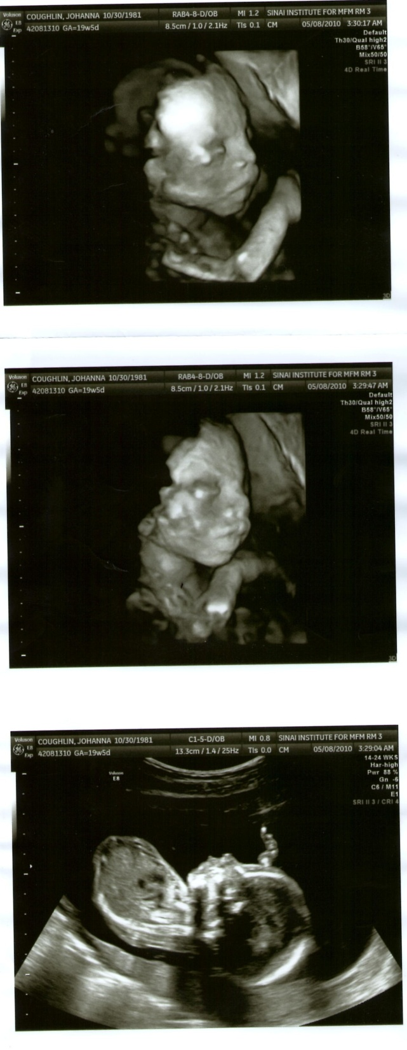
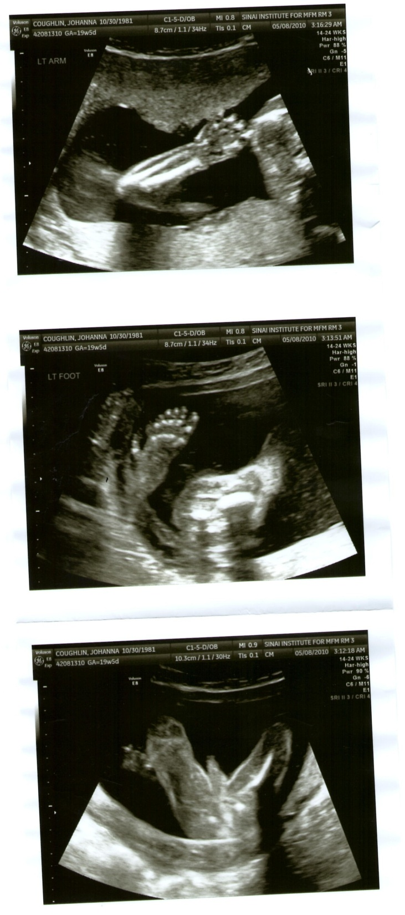
Only One Essential Question
What are the unborn?
Notes:
TROT OUT THE TODDLER (see below)
Pro-life 101, adapted from Scott Klusendorf. The Case for Life. Crossway Books: Wheaton, IL (2009). This book is an invaluable reference and will provide answers to any question that might be raised. It is available at amazon.com.
There is only ONE essential question in the abortion debate: What are the unborn?
Other issues like teen pregnancy, rape, fear, single parenthood, etc. are not unimportant. They must be addressed with kindness, compassion, and support.
Each individual woman or man has unique needs, concerns, and circumstances. Each should be treated with the love of Christ.
However, none of these issues warrants taking the life of the unborn.
These can distract from the central issue in the abortion debate. They assume the unborn are not human.
To illustrate, “trot out the toddler.”
eg. Imagine I have a 2 year old in front of me (hold out your hand to a toddler height to illustrate). If the issue is privacy, may I kill him in the privacy of a bedroom or clinic? If the issue is poverty, and I have a large family on the brink of bankruptcy, may I kill the youngest member to ease my financial burdens? If the issue is rape, we must ask ourselves how we choose to treat those people who remind us of painful events in our lives.

Slide 5
The only differences between that zygote or embryo and you today are:
SIZE
LEVEL OF DEVELOPMENT
        Are large people more valuable than small people?
        Are short people less valuable than tall people?
        Are infants or 4 year olds or 23 year olds less valuable than 40 year olds?
        Are 80 year olds more or less valuable than 10 year olds?
ENVIRONMENT
DEGREE OF DEPENDENCY
        Does changing location make someone valuable?
        Are those who depend on insulin or feeding tubes less valuable than others?
        Since infants cannot survive without relying on others for food, are they less valuable than children?
Notes:
The only difference between that zygote or embryo and you today is
Size
Are large people more valuable than small people?
Level of development
Are infants or 4 year olds less valuable than adults?
Environment
Does changing location make someone valuable?
Degree of dependency
Are those who depend on insulin or feeding tubes less valuable than others? Since infants cannot survive without relying on others for food, are they less valuable than children?

Slide 6
  “The revelation of the Gospel of life is given to us as a good to be shared with all people. . . . Our own joy would not be complete if we failed to share this Gospel with others but kept it only for ourselves.”
  Evangelium Vitae n. 101.
Notes:
This is up to you
If not you, who? If not now, when?

Slide 7

Tough Questions
Speak the truth with compassion.
Pray and let the Holy Spirit speak through you.

Slide 8
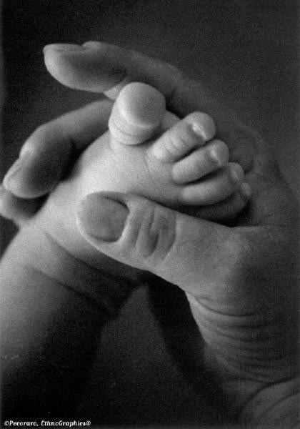
“First they came for the Jews, and I did not speak out because I was not a Jew. Then they came for the Communists, and I did not speak out because I was not a Communist. Then they came for the trade unionists, and I did not speak out because I was not a trade unionist. Then they came for me, and there was no one left to speak out for me.”
- Rev. Martin Niemöller
Notes:
Reiterate essential lessons
There is objective truth.
This truth includes that abortion, euthanasia, and assisted suicide are grave evil.
Your peers and your community suffer from misinformation about these evils. They may also suffer post-abortion grief, struggle with end-of-life issues regarding a relative or friend, or be in a crisis pregnancy.
Speak the truth with heartfelt compassion. Compassion (com-passio) means to “suffer with” the other.
You are responsible for building the culture of life. If not you, who? If not now, when?

