Slide 1
Training for
Crisis Response
April 26, 2014

Slide 2


Slide 3


Slide 4
“Come to me, all you who labor and are burdened,* and I will give you rest.

Slide 5
Lord, You invite all who are burdened to come to you. Allow Your healing Hand to heal me. Touch my soul with Your compassion for others; touch my heart with Your courage and infinite Love for all; touch my mind with Your Wisdom, and may my mouth always proclaim Your praise. Teach me to reach out to You in all my needs, and help me to lead others to You by my example.
Most loving Heart of Jesus, bring me health in body and spirit that I may serve You with all my strength. Touch gently this life which you have created, now and forever.
Amen.

Slide 6
Archdiocesan Response Team

Slide 7

Archdiocesan Response Team

Slide 8
Archdiocesan Response Team

Slide 9
Archdiocesan Response Team
The Archdiocesan Response Team provides ministerial support in times of darkness and overwhelm. The Archdiocesan Response Team is a ministry of hope and healing.

Slide 10
Best Practices
Archdiocesan Response Team

Slide 11
Where we are
School/parish has received bad news
Administrator has notified AoB
Team has been requested
Point person is designated as central contact for school/parish and team

Slide 12
Responsibilities of Point Person
Point person acts as liaison between all constituents- AoB, school/parish, and the ART members assigned to the situation
Point supports site leader (principal/DRE/youth minister) in putting together all communications
Point works with administrator to determine resources on property and determine how to utilize them- counselor, priests,
Point directs the actions of the ART the day of the event
Point provides summary to AoB after the event
Whenever possible, point is left to provide support and problem solve during the event, rather than being assigned to a specific group or task

Slide 13
Timeline
Faculty/staff is notified by phone tree ASAP
Meeting is scheduled 30 minutes prior to the next school day (earlier if the emotional impact is very high)- nice to have coffee and light breakfast, if possible
Point works with administrator to put together a statement for faculty, plan faculty meeting
Point arrives 30 minutes before faculty meeting to finalize arrangements
Faculty meeting- run jointly by administrator and point
Team disseminates to provide classroom/hall support- someone is available in a quiet room to work with students unable to stay in class
Process in classroom groups
Return to routine
Team meets to debrief

Slide 14
The Meeting
Introduce team
Debrief staff using the debriefing triangle
Set up plans for the day
  Who will be assigned where- assign team as needed to most sensitive areas
  How to debrief the class
  Plan for an activity
  Pastoral Care cross
  When normal schedule will resume
  How long team will remain
Control rumors- be as truthful as possible, respecting family’s privacy
Identifying areas/students/staff of greatest concern
Staff needs to be given sufficient time to process before meeting students

Slide 15
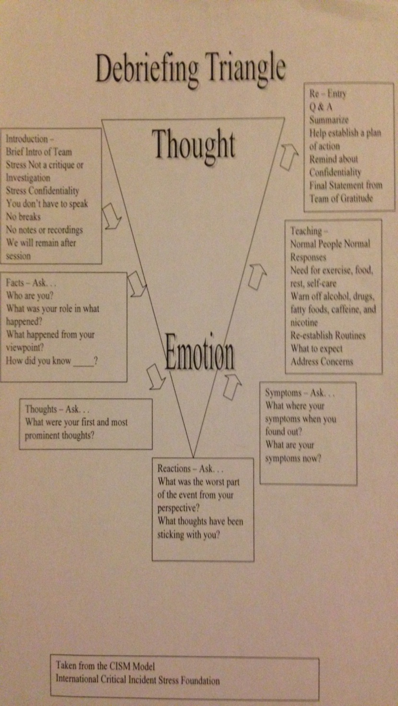
Debriefing Triangle

Slide 16
Special circumstances- suicide
VERIFY
Can only share details that we have permission to share or are part of public record
Understand the pastoral nature of church teaching
Kids can tell if you are “snowing” them
Do not publicly share method

Slide 17
Special circumstances- media
If the situation might bring media attention, AoB must be notified
Sean Caine will direct media response
No one is required to speak to the media
Media is not allowed on private property
Staff will need to set up situation that best protects students

Slide 18
Practice
Set up a timeline for the events that need to occur to support this crisis
List any essential questions
Divide and assign your team
Put together a list of important details for communications to families
Put together a list of conversation starters for each level of the debriefing triangle
List populations of greatest concern

Slide 19

Notification

Slide 20
Who is the primary contact with parents / family?
What are the details of the diagnosis that they are willing to share? With whom?
Who are the community players that need to be involved?
What are our goals? (Continually re-assess)
Notification

Slide 21
Notification

Slide 22

Environmental Changes
For Diagnosed
Notification

Slide 23
Environmental Changes
What are the physical implications? Emotional / behavioral implications (reluctance to return)? Learning disabilities?
Implications of part-time attendance? Home work / work from home?
Be cognizant of the variety of resources available locally and nationally to students and their families
For Diagnosed
Notification

Slide 24

Environmental Changes
For
Community
For Diagnosed
Notification

Slide 25
Environmental Changes
Communicate first with parents of the diagnosed. They control release of information.
Communicate, resource parents
Communicate with students providing straightforward, reassuring answers to children's questions
Address myths, reduce fear, confusion:
Is it contagious?
How did he/she it?
What are my chances of getting it?
Will it go away? come back?
Encourage Student to speak about their feelings
For
Community
For Diagnosed
Notification

Slide 26

Environmental Changes
Long-Term
Absence
For
Community
For Diagnosed
Notification

Slide 27
Environmental Changes
Communicate first with parents of the diagnosed.
Recognize the potential for long-term absences. Continue to provide communication and needs assessment regarding what is wanted and needed
On-going prayer. Address healing, peace
Do Something. How to support
Monitor and Address the needs of “close friends”
Long-Term
Absence
For
Community
For Diagnosed
Notification

Slide 28


Slide 29
Environmental Changes
Long-Term
Absence
For
Community
For Diagnosed
Notification

Slide 30
Environmental Changes
Long-Term
Absence
For
Community
For Diagnosed
Notification
Life

Slide 31
Environmental Changes
Engaged in plans regarding transition, return
Celebrate, recognize the community’s support
Get back to normal.
Long-Term
Absence
For
Community
For Diagnosed
Notification
Life

Slide 32

Environmental Changes
Long-Term
Absence
For
Community
For Diagnosed
Notification
Death
Life

Slide 33
Environmental Changes
Discretely, see it coming
Plan for communication with parents and students
Plan for processing, contextualizing the experience
Plan for commemorating
Plan for memorializing
When appropriate, communicate with the parents of the deceased.
Implement Plan
Care for Self
Get Back to Normal
Long-Term
Absence
For
Community
For Diagnosed
Notification
Death
Life

Slide 34
Environmental Changes
Long-Term
Absence
For
Community
For Diagnosed
Notification
Death

