Slide 1

The Good News about Life
Archdiocese
of Baltimore

Slide 2
What are you facing?

Slide 3

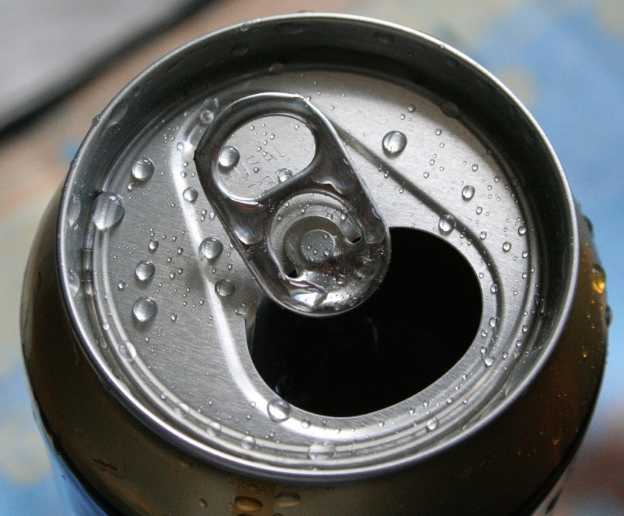
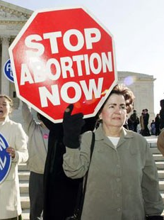
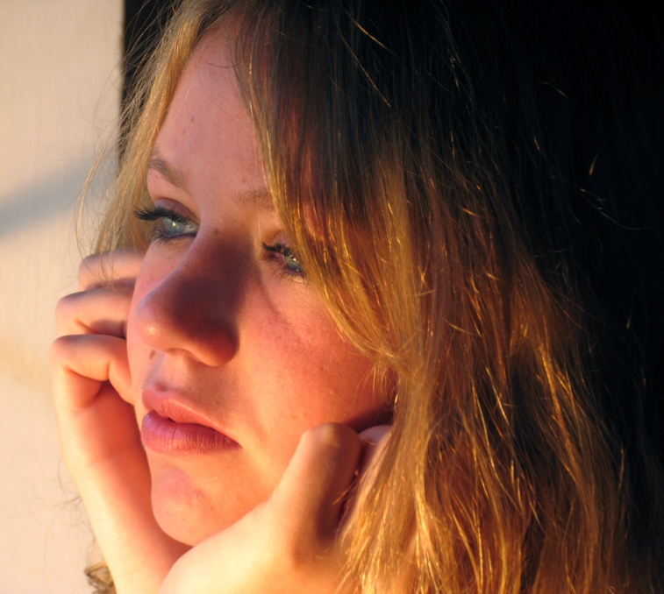
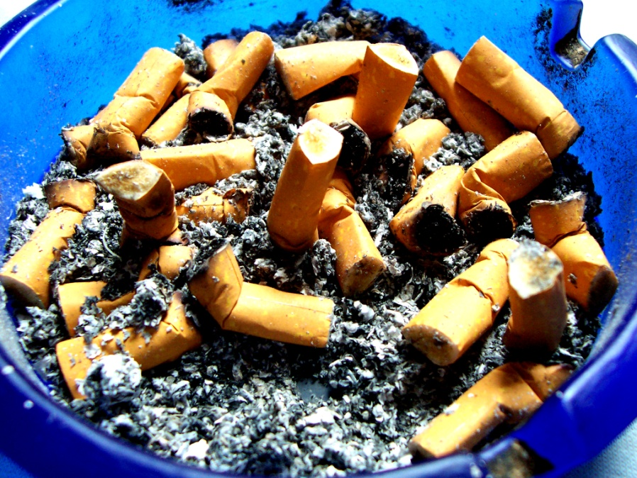
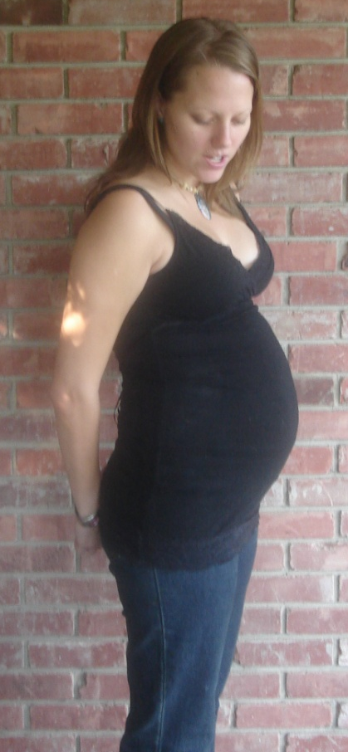
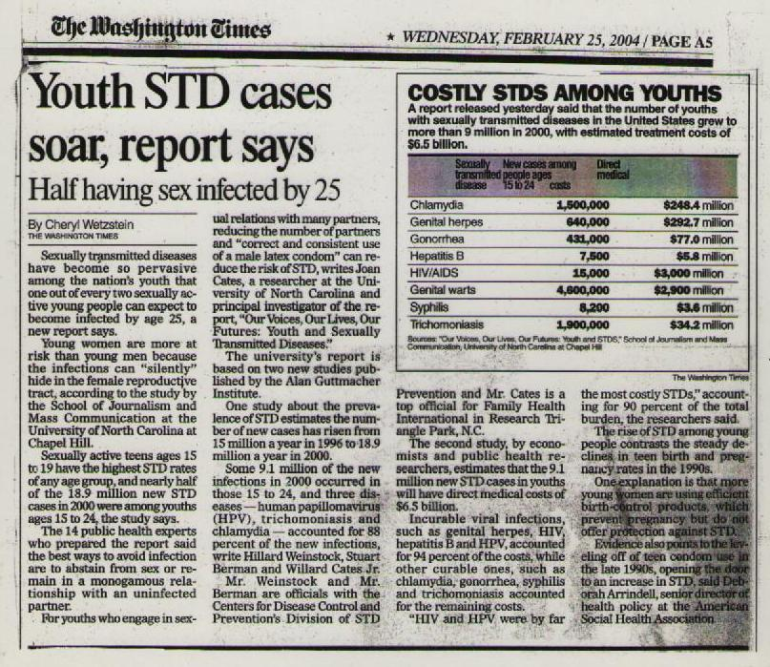

What are you facing?
Unplanned Pregnancy
Abortion
Sexually Transmitted Infections
Binge Drinking
Illegal Drug Use
Smoking
Infertility
Suicide

Slide 4
Who and what influence you?

Slide 5
legal - [lee-guh l] – permitted by law; lawful
moral - [mawr-uh l] - of, pertaining to, or concerned with the principles or rules of right conduct or the distinction between right and wrong; ethical
conception – [kuh n-sep-shuh n] - fertilization; inception of pregnancy
embryo – [em-bree-oh] - the young of a viviparous (bringing forth living young) animal, especially of a mammal, in the early stages of development within the womb, in humans up to the end of the second month
fetus – [fee-tuh s] – the young of an animal in the womb or egg, especially in the later stages of development when the body structures are in the recognizable form of its kind, in humans after the end of the second month of gestation
abortion – [uh-bawr-shuh n] – also called voluntary abortion. the removal of an embryo or fetus from the uterus in order to end a pregnancy

Slide 6
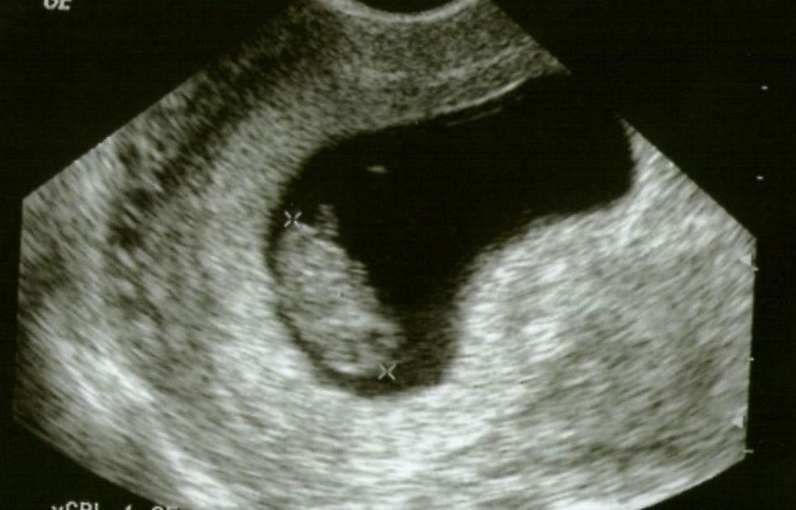
At the moment of conception, there is
DISTINCT, LIVING, WHOLE human being.
    “Before I formed you in the womb I knew you, and before you were born I consecrated you.” - Jeremiah 1:5
None of us came from an embryo.
Each of us was an embryo.

Slide 7
The only differences between a zygote or an embryo and you today are:
SIZE
LEVEL OF DEVELOPMENT
        Are large people more valuable than small people?
        Are short people less valuable than tall people?
        Are infants or 4 year olds or 23 year olds less valuable than 40 year olds?
        Are 80 year olds more or less valuable than 10 year olds?
ENVIRONMENT
DEGREE OF DEPENDENCY
        Does changing location make someone valuable?
        Are those who depend on insulin or feeding tubes less valuable than others?
        Since infants cannot survive without relying on others for food, are they less valuable than children?
Notes:
The only difference between that zygote or embryo and you today is
Size
Are large people more valuable than small people?
Level of development
Are infants or 4 year olds less valuable than adults?
Environment
Does changing location make someone valuable?
Degree of dependency
Are those who depend on insulin or feeding tubes less valuable than others? Since infants cannot survive without relying on others for food, are they less valuable than children?

Slide 8
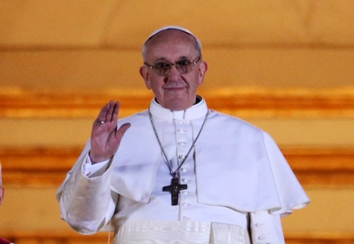
abortion
adoption
fear
choice
1973
clinic
abortionist
viability
post abortion stress
pro-life
legal
morality
fatherhood
motherhood
coercion
Doe v. Bolton
Roe v. Wade
regulation

Slide 9


Slide 10
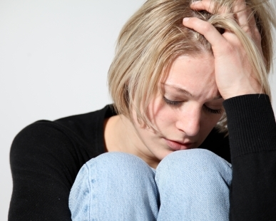

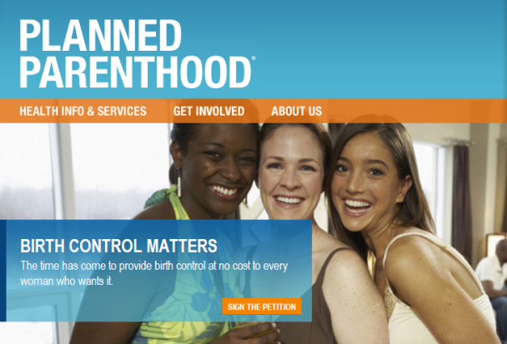
The “Who?” of Abortion
Mothers
Fathers
Planned Parenthood

Slide 11
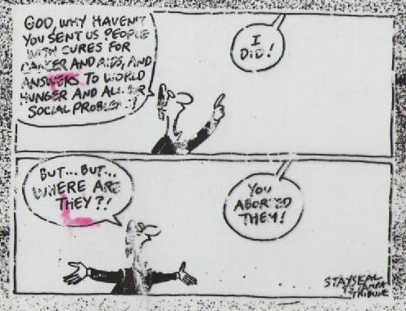

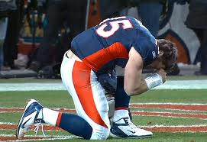

The “Who?” of Abortion
The unborn
YOU

Slide 12
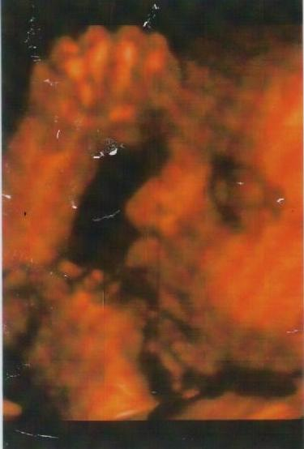
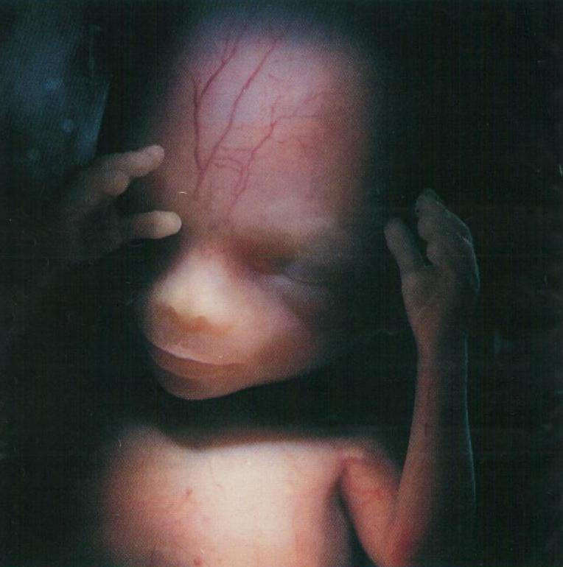
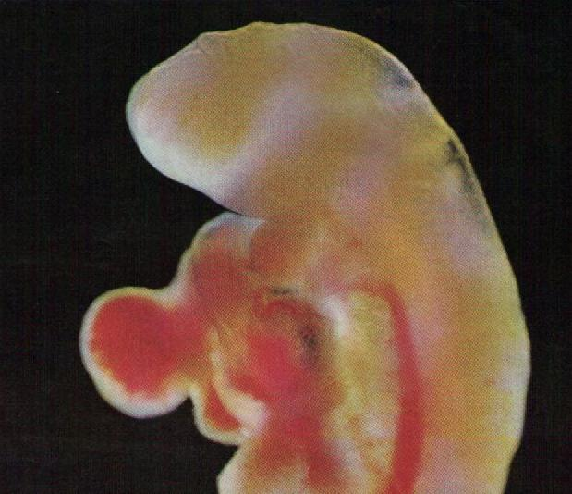
The “When?” of Abortion

Slide 13
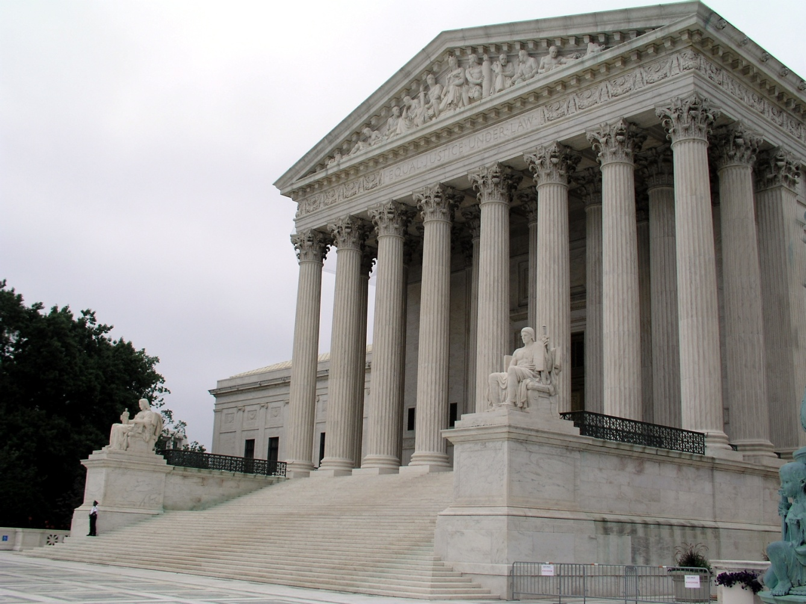
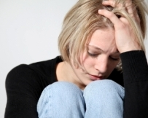
The “Why?” of Abortion
A state has the right to regulate or proscribe abortion “except where it is necessary, in appropriate medical judgment, for the preservation of the life or health of the mother.” (1)
“[T]he medical judgment may be exercised in the light of all factors - physical, emotional, psychological, familial, and the woman's age - relevant to the wellbeing of the patient. All these factors may relate to health.” (2)
1 Roe v. Wade, 410 U.S. 164-5 (1973).
2 Doe v. Bolton, 410 U.S. 179, 192 (1973).
64% of women report some form of coercion in the abortion decision.
The Jericho Plan: Breaking Down the Walls Which Prevent Post-Abortion Healing, by David C. Reardon. Springfield, IL: Acorn Books, 1996.

Slide 14
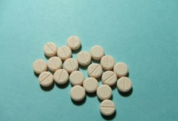
The “How?” of Abortion
Contraceptives
Morning After Pill
IUD’s
RU-486
Suction
Saline
D&C
D&E
D&X/Partial-Birth Abortion

Slide 15
Abortion
Who?
What?
When?
Where?
Why?
How?

Slide 16

The “Tough” Questions
“trot out the toddler”
Rape
Incest
Disabilities
Life of the Mother

Slide 17
When does life begin?

Slide 18

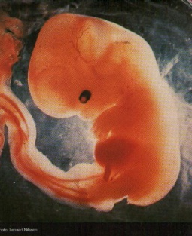
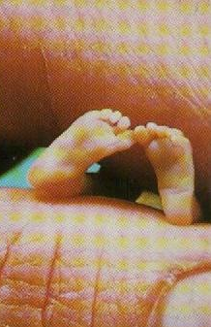
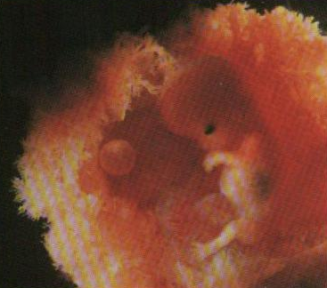
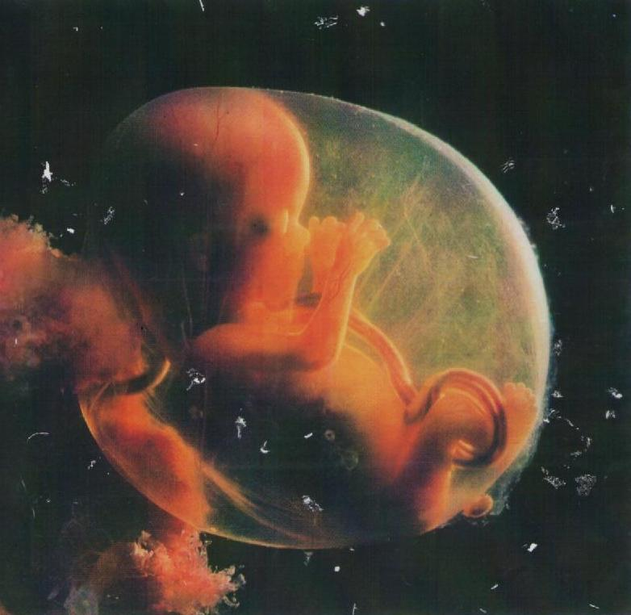
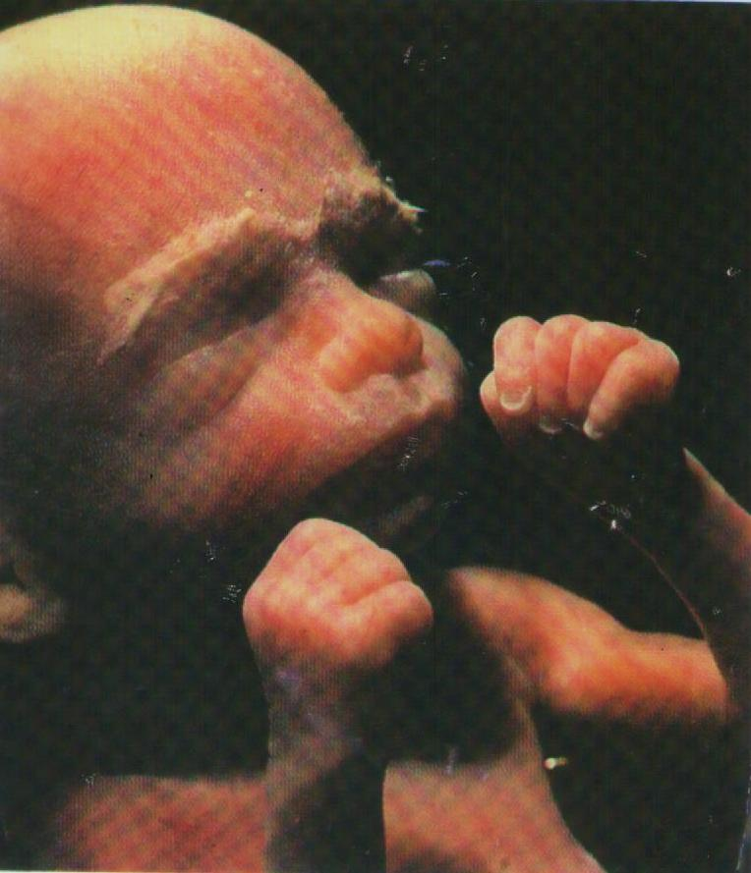
4 weeks after fertilization
6 weeks
11 weeks
12 weeks
16 weeks
20 weeks
22 weeks

Slide 19
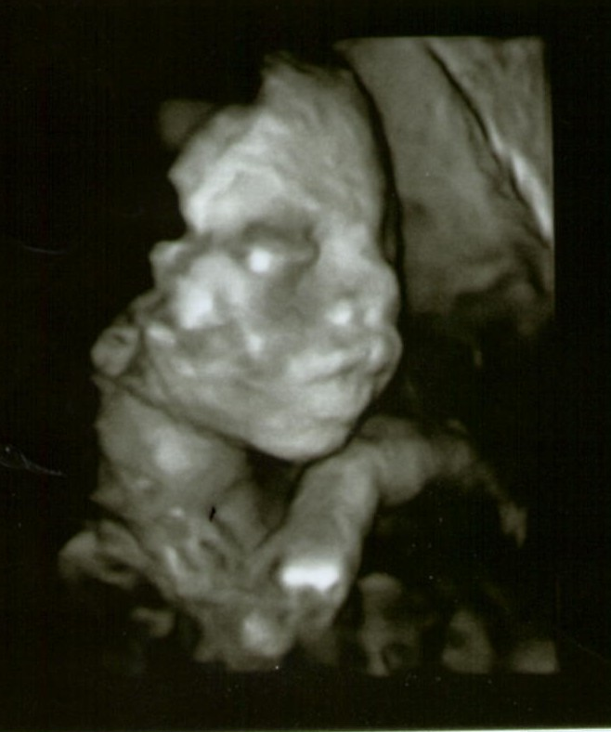
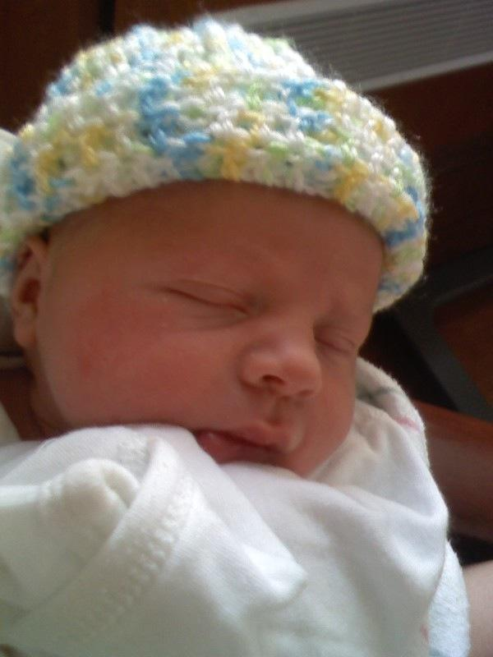
Sonography: A Window to the Womb
20 weeks later
⇢
Tommy David

Slide 20


Post Abortion Stress
suicide • sleep disorder • absence of choice
child abuse • pressure • depression • anxiety
www.rvbaltimore.org
410-625-8491

Slide 21
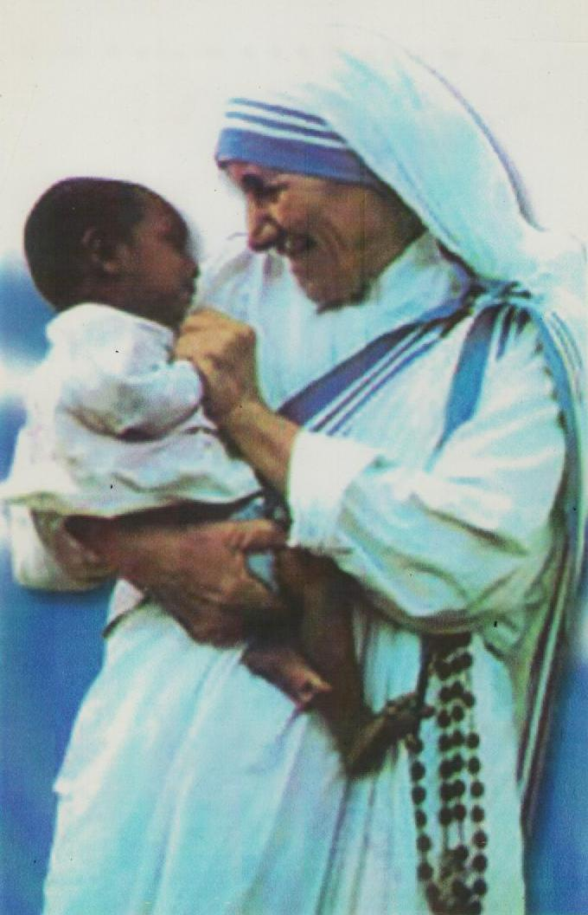
“the greatest destroyer of peace today is abortion”

Slide 22
CHASTITY
purity in conduct and intention
      personal integrity
self mastery
accepts and respects the body in its sexual dimensions and is grateful for it
“profoundly related to our personal identity and destiny”
It is not impossible
a grace and a gift for those who request it
marks the entire personality of a human being
Chastity can be maintained only through effort,
honesty and prayer.

Slide 23


The Church is not concerned about human sexuality because it is bad but because it is so good and so important to personal freedom, social life, and human happiness.
  You decide NOW how to take care of your sexuality.
  Take it seriously.

Slide 24
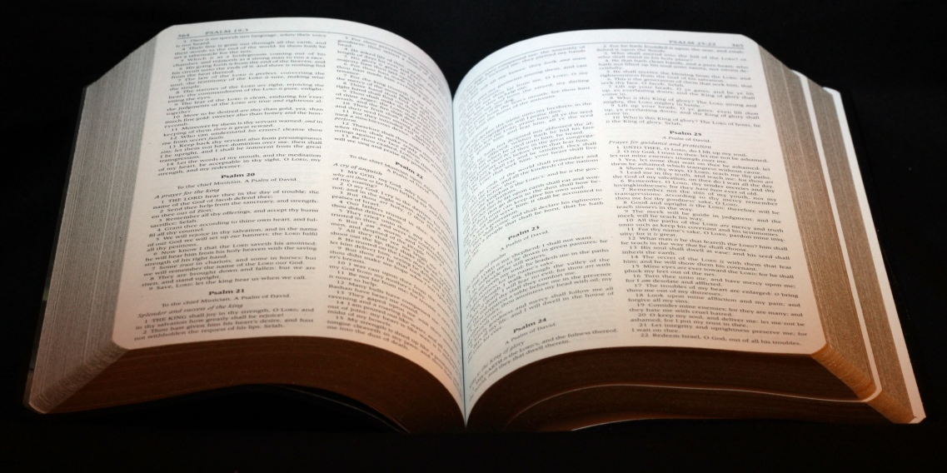
The Bible, Creation, & Sexuality
“and God looked at everything he had made, and he found it very good.” Genesis 1:31
    “the two of them become one body” Genesis 2:24
    “If you remain in my word, you will truly be my disciples, and you will know the truth, and the truth will set you free.” Jn. 8:32.

Slide 25
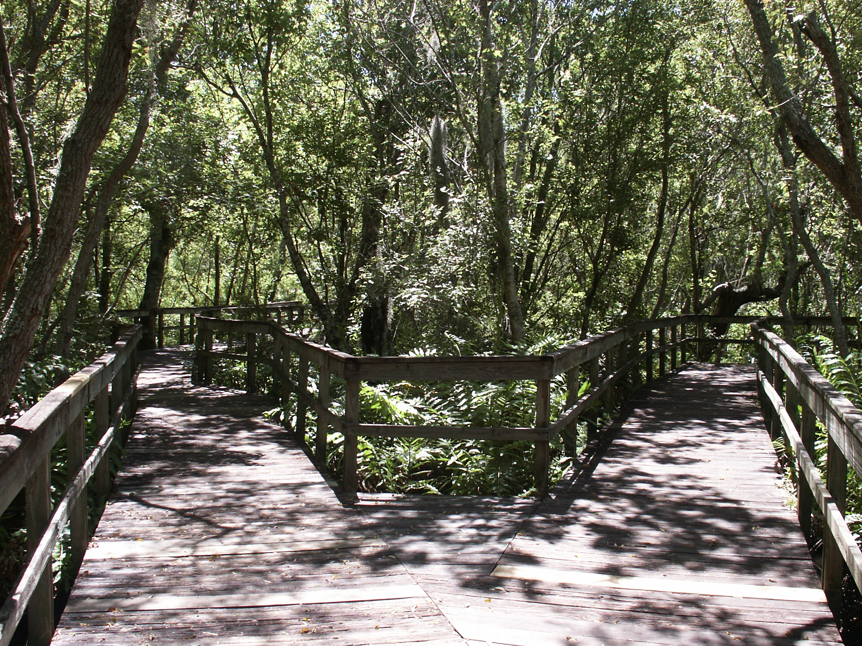
    The Road Not Taken
    Robert Frost
    Two roads diverged in a yellow wood,
    And sorry I could not travel both
    And be one traveler, long I stood
    And looked down one as far as I could
    To where it bent in the undergrowth.
    Then took the other, as just as fair,
    And having perhaps the better claim,
    Because it was grassy and wanted wear;
    Though as for that the passing there
    Had worn them really about the same.
    And both that morning equally lay
    In leaves no step had trodden black.
    Oh, I kept the first for another day!
    Yet knowing how way leads on to way,
    I doubted if I should ever come back.
    I shall be telling this with a sigh
    Somewhere ages and ages hence:
    Two roads diverged in a wood, and I--
    I took the one less traveled by,
    And that has made all the difference.

Slide 26
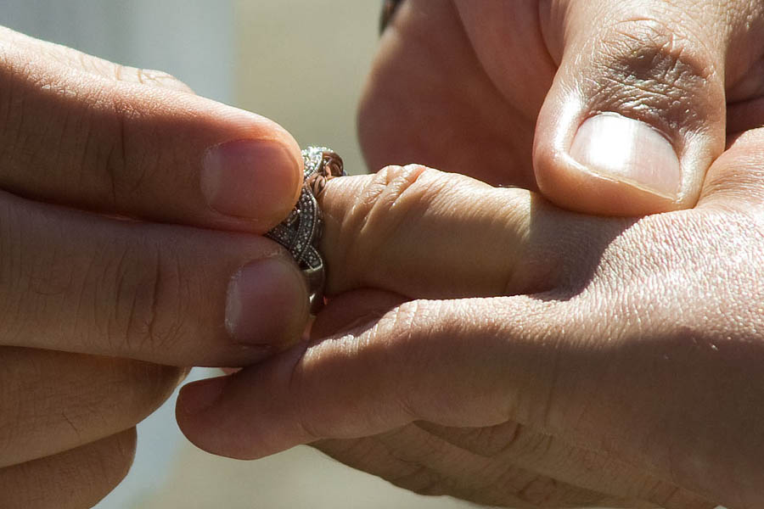
“do you take this woman . . .?”
Proper use of sexuality demands relationships that have:
  dignity
  commitment
  permanency
  stability
  openness to children
Husbands, love your wives, even as Christ loved the church. Ephesians 5:25
God created man in his image; in the divine image he created him; male and female he created them. God blessed them, saying: "Be fertile and multiply” Genesis 1:27-28

Slide 27
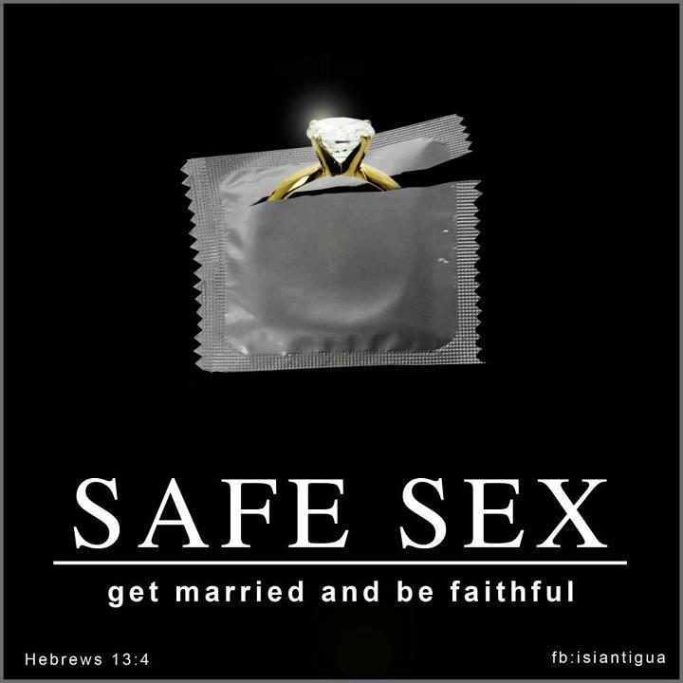
Contraception: Why Not?

Slide 28
You are Special
  I’m special. In all the world there’s nobody like me.
    Since the beginning of time, there has never been another person like me. Nobody has my smile. Nobody has my eyes, my nose, my hair, my hands, my voice. I’m special.
    No one can be found who has my handwriting.
    Nobody anywhere has my tastes – for food or music or art. No one sees things just as I do.
    In all of time there’s been no one who laughs like me, no one who cries like me. And what makes me laugh and cry will never provoke identical laughter and tears from anybody else, ever.
    No one reacts to any situation just as I would react.
    I’m special.
    I’m the only one in all of creation who has my set of abilities. Oh, there will always be somebody who is better at one of the things I’m good at, but no one in the universe can reach the quality of my combinations or talents, ideas, abilities, and feelings. Like a room full of musical instruments, some may excel alone, but none can match the symphony sound when all are played together. I’m a symphony.
    Through all of eternity no one will ever look, talk, walk, think or do like me. I’m special. I’m rare.
    And, in all rarity, there is great value.
    Because of my great rare value, I need not attempt to imitate others. I will accept – yes, celebrate – my differences.
    I’m special. And I’m beginning to realize it’s no accident that I’m special. I’m beginning to see that God made me special for a very special purpose. He must have a job for me that no one else can do as well as me. Out of all the billions of applicants, only one is qualified, only one has the right combination of what it takes.
    That one is me. Because . . . I’m special.
    ***

Slide 29
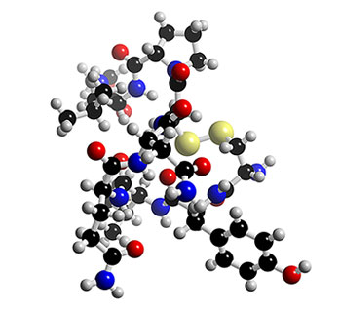
There is no casual sex . . .
dopamine • oxytocin • vasopressin • seratonin
Clouded judgment & confusion
Intense break ups & depression
Damage to current relationship
Damage to future relationships
Science now backs up what religious traditions have been teaching for generations. Who knew?
Oh yeah. Him.

Slide 30
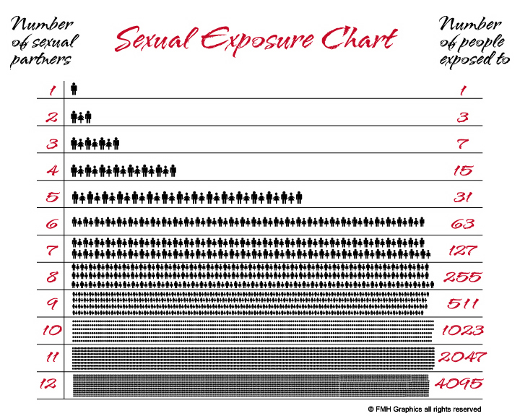

Slide 31
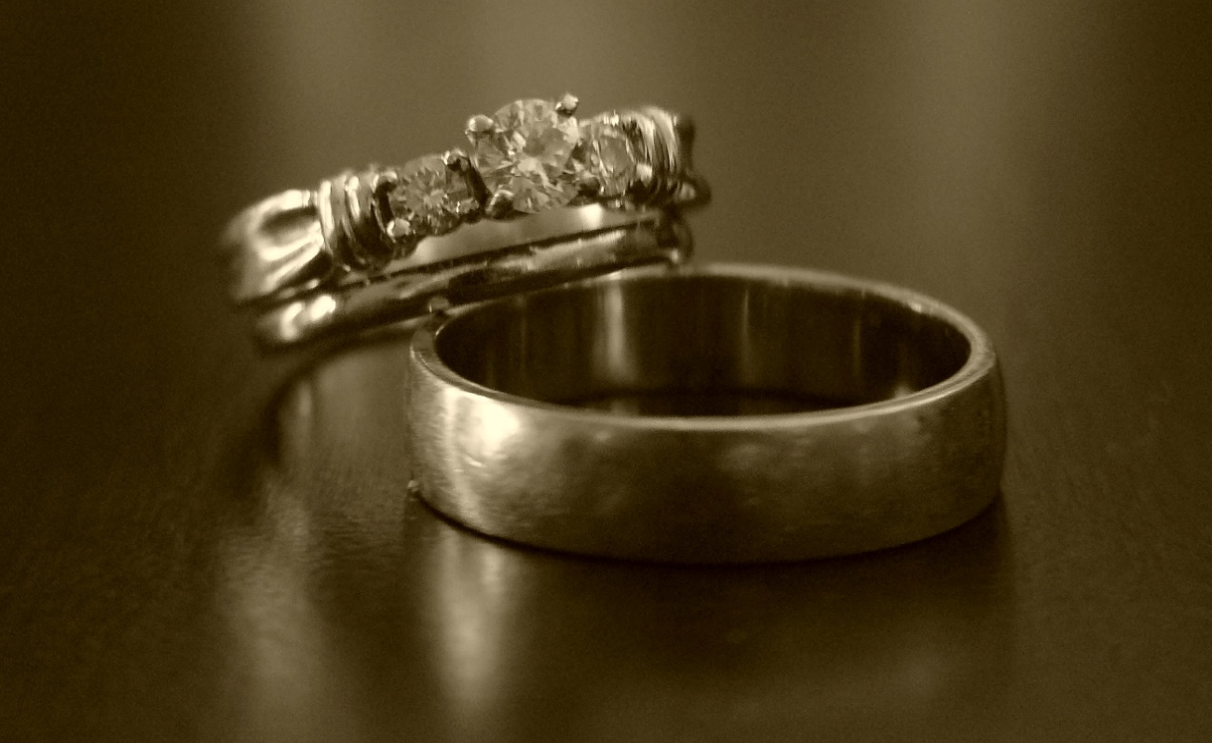
What about “Safe Sex”?
Instead: Save Sex
no regrets • fidelity • healthiness • purity • chastity • respect • holiness • happiness
      Brothers and sisters: The body is not for immorality, but for the Lord, and the Lord is for the body; God raised the Lord and will also raise us by his power. Do you not know that your bodies are members of Christ? But whoever is joined to the Lord becomes one Spirit with him. Avoid immorality. Every other sin a person commits is outside the body, but the immoral person sins against his own body. Do you not know that your body is a temple of the Holy Spirit within you, whom you have from God, and that you are not your own? For you have been purchased at a price. Therefore glorify God in your body.
      1 Corinthians 6:13-15, 17-20

Slide 32

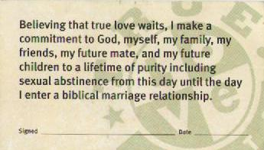
True Love Waits

Slide 33
Why Chastity?
Freedoms from:
  Pregnancy
  Hurry-up wedding
  Adoption decision
  Abortion decision
  Guilt
  Sexually transmitted diseases
  Cancer of the cervix
  Hazards of birth control
  Self-induced sterility
  Being used
  Loss of reputation
  Ruining your future
Freedoms to:
  Develop friendships
  Help others
  Understand sex
  Resist temptation
  Plan your future

Slide 34
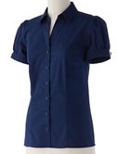
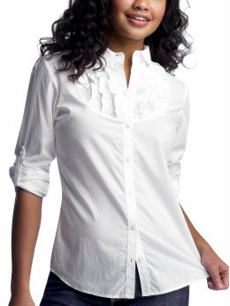
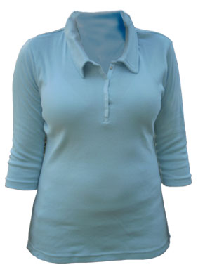
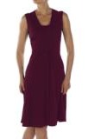
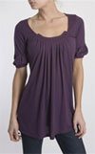
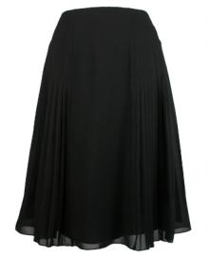


Modesty – bring back the grace
“How you look on the outside is a reflection of your heart on the inside”
“If it’s not for sale, then don’t advertise”
Pornography

Slide 35
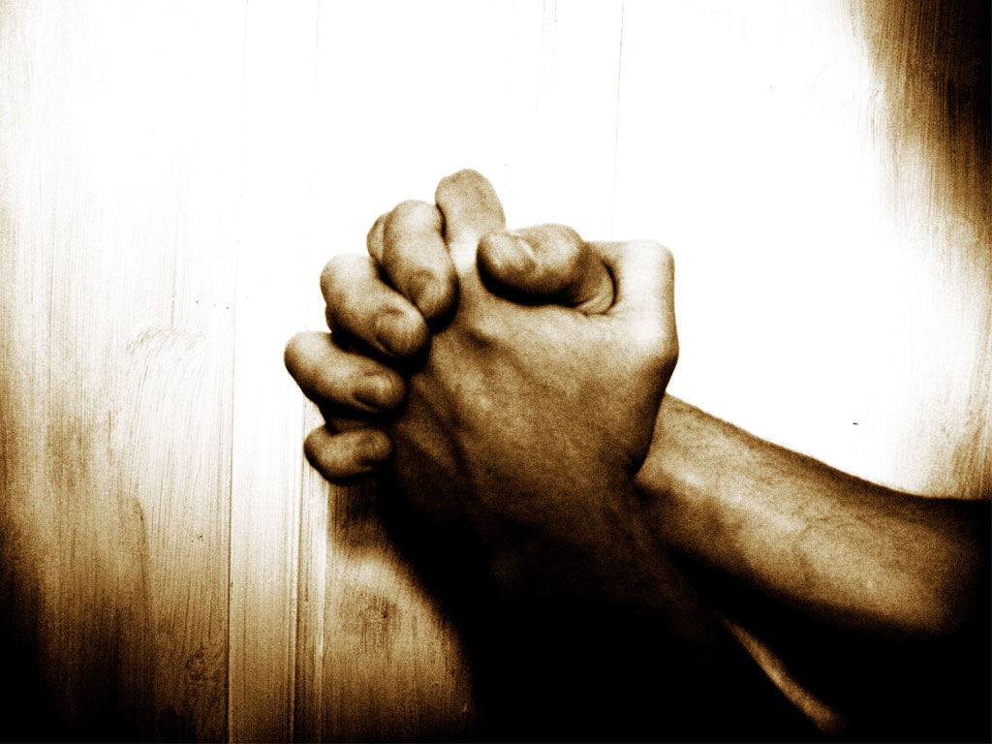
made a mistake? thank God for forgiveness!
Why do people choose secondary virginity?
How do I become a secondary virgin?
  Desire to be forgiven and go to Confession
  Decide to change
  Detach from old habits
  Develop non-genital ways of sharing
      The worry wasn’t worth it
      I dislike what I saw in the mirror in the morning
      The sex thrill wasn’t really satisfying
      Frankly I was scared of herpes
My prayer life was almost nonexistent – I felt too guilty to talk to God
      I didn’t like being used
      I got pregnant; he left and I said “never again”
      Just because I made a mistake doesn’t mean I have to keep on making the same mistake
      We were so much into sex that we never became friends

Slide 36
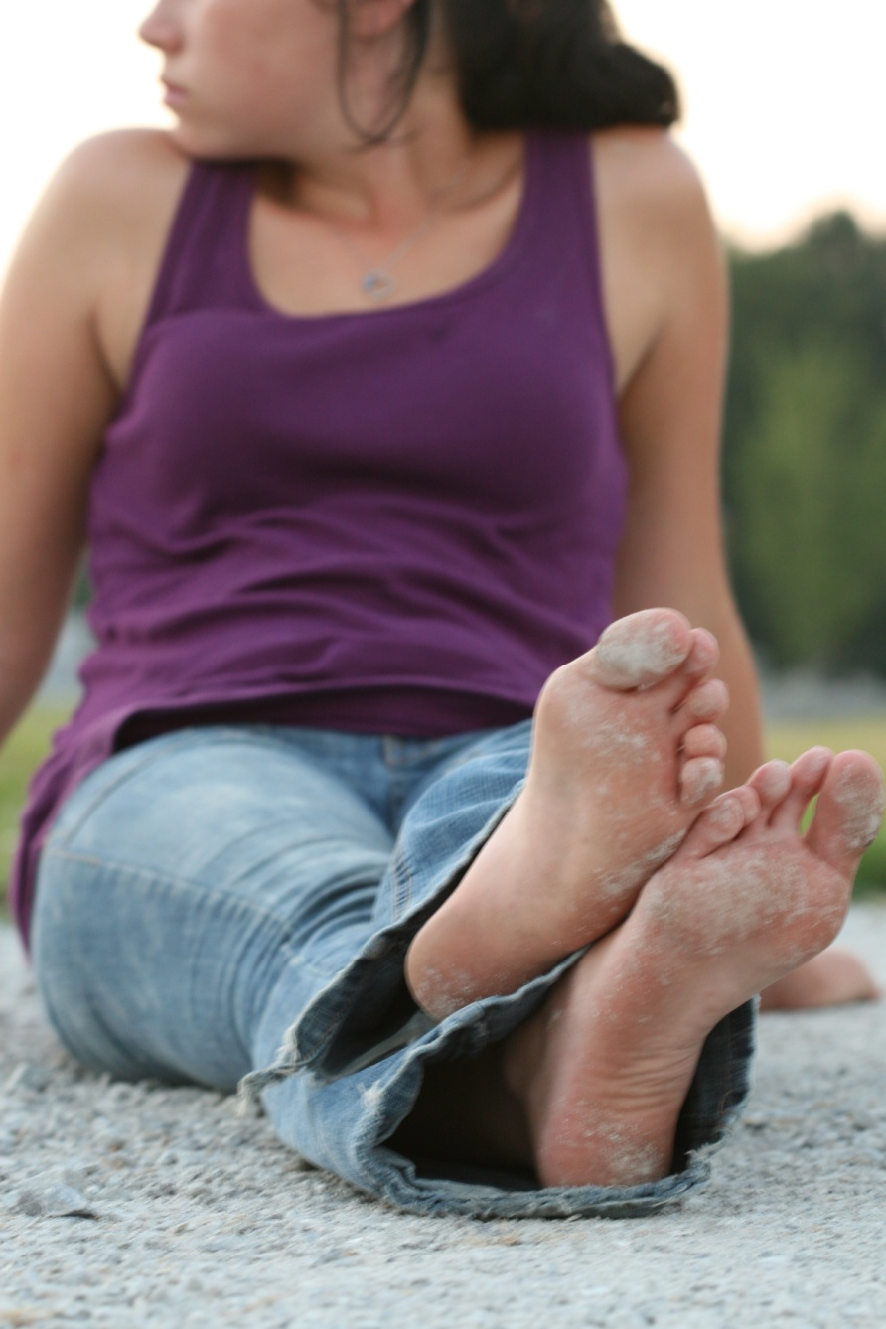
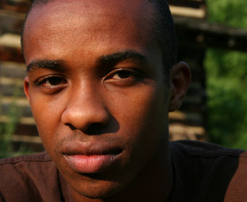

Slide 37
Dearest Jesus!
I know well that every perfect gift, and above all others that of chastity, depends upon the most powerful assistance of your providence, and that without you a creature can do nothing.
Therefore, I pray that you defend, with your grace, the gift of chastity and purity in my soul as well as my body. And if I have ever received through my senses any impression that could stain my chastity and purity, I ask you, who are the supreme Lord of all my powers, to take it from me, so that I may with a clean heart advance in your love and service, offering myself chaste all the days of my life on the most pure altar of your divinity.
    Amen.

