Slide 1

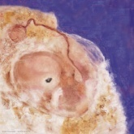
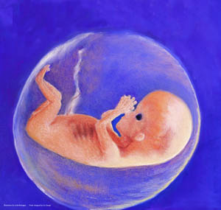

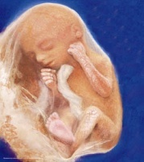

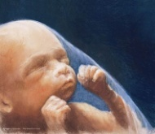

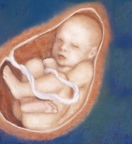
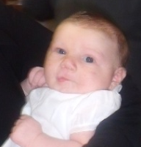
Day 1:
Life Begins!
Thank you for participating in this Spiritual Adoption program! We hope you enjoy it. You will receive information with updates on your spiritually adopted baby’s development each month.
Already, your spiritually adopted baby is a wonder! Even though she is only one cell, everything about this little person is already present: eye color, blood type, how tall she will be, hair color-everything! This baby will play a role in our community only she can play! This baby’s parents do not even know she exists yet—please pray for them to safely bring their baby to birth so she can fulfill the mission God has planned for her.
http://www.archbalt.org/family-life/respect-life/spiritual-adoption/ Information on the developing baby was taken from: Abortion: Questions and Answers, Dr. and Mrs. John C. Wilke, © 1985, Hayes Publishing Company, Inc., Cincinnati, OH. Illustrations(c)L.Brenegan 2001 – may not be reprinted without express permission of the artist.

Slide 2

4 Weeks - End of Month 1
“My heart is beating!”
Thank you for praying for me. I am one month old now. I have a heart pumping my blood and a backbone. I am very, very tiny and I appreciate your prayers.
Did you know?
Your baby is already 10,000 times bigger than at conception
He has developed the foundations of his brain, spinal cord, and nervous system by the 20th day
Your baby’s heart began to beat on the 21st day
His blood type can be different from his mother’s
Your baby is very vulnerable to abortion during this next month—thanks for your prayers!
http://www.archbalt.org/family-life/respect-life/spiritual-adoption/ Information on the developing baby was taken from: Abortion: Questions and Answers, Dr. and Mrs. John C. Wilke, © 1985, Hayes Publishing Company, Inc., Cincinnati, OH. Illustrations(c)L.Brenegan 2001 – may not be reprinted without express permission of the artist.

Slide 3
8 Weeks - End of Month 2
“I am dancing!”
Thank you for praying for me. I am two months old now and about 2 inches long. Look! You can see my eyes, nose, and mouth. I will use them to experience God’s world after I am born.
Guess what?
Your baby is making progress developing all of her external features and internal organs.
Her brain is functioning at 40 days.
Everything your baby needs to survive after birth is already present by the end of the 8th week!
She loves to hop, jump and flip – her first dance steps!
http://www.archbalt.org/family-life/respect-life/spiritual-adoption/ Information on the developing baby was taken from: Abortion: Questions and Answers, Dr. and Mrs. John C. Wilke, © 1985, Hayes Publishing Company, Inc., Cincinnati, OH. Illustrations(c)L.Brenegan 2001 – may not be reprinted without express permission of the artist.

Slide 4
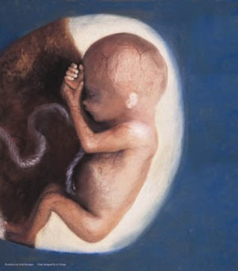
12 weeks - End of Month 3
“I can suck my thumb!”
Thank you for praying for me. I’m three months old now. I’m about 3 inches long and I weigh one ounce. That’s not much, but I’m fully formed and can even suck my thumb!
We are at the end of the first trimester! Your spiritually adopted baby is becoming very active in the womb now. Here are some things he can do:
Squint
Swallow
Move his tongue
Make a tight fist if you touch his palm
http://www.archbalt.org/family-life/respect-life/spiritual-adoption/ Information on the developing baby was taken from: Abortion: Questions and Answers, Dr. and Mrs. John C. Wilke, © 1985, Hayes Publishing Company, Inc., Cincinnati, OH. Illustrations(c)L.Brenegan 2001 – may not be reprinted without express permission of the artist.

Slide 5

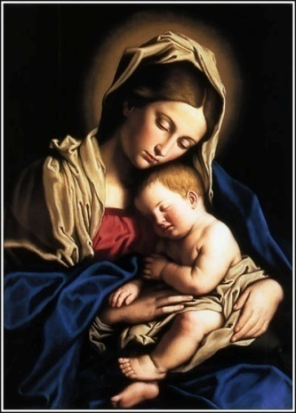
16 Weeks - End of Month 4
“I had a dream today!”
Thank you for praying for me. I’m bigger and stronger now. I’m about 6 inches long and I weigh 4 ounces. When mommy goes to the doctor, she can even listen to my heartbeat! I hope that one day I will run and play with friends like you.
Prayer to Mary,
Mother of the Life Within
O Mary, Mother of the Life Within,
all life we entrust to you;
The life of every expectant mother
and the child within her womb:
The life of every human body,
the life of every human soul;
The life of every newborn child
and the life of all grown old.
You held the Lord to your own heart
and drew Him so close in.
So draw us now in all our needs,
O Mother of the Life Within.
Amen
REMs (rapid eye movements) have been observed at this age – a sign of dreaming. Keep praying so she can fulfill her dreams.
http://www.archbalt.org/family-life/respect-life/spiritual-adoption/ Information on the developing baby was taken from: Abortion: Questions and Answers, Dr. and Mrs. John C. Wilke, © 1985, Hayes Publishing Company, Inc., Cincinnati, OH. Illustrations(c)L.Brenegan 2001 – may not be reprinted without express permission of the artist.

Slide 6
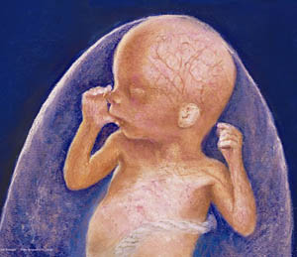
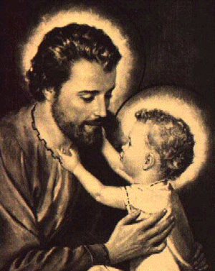
20 Weeks - End of Month 5
“Mommy felt me kick today!”
I am 5 months old now. I’m 12 inches long and I weigh about one pound. I’m really getting big and mommy can now feel me kick and move around! Hey! Someday maybe I’ll play soccer! Thank you for praying for me!
We are now mid-way through the pregnancy! Your spiritually adopted baby is growing stronger each day, and now can kick hard enough for his mother to feel.
This month, please say a special prayer to St. Joseph for the father of your spiritually adopted baby, that he the courage and strength he needs to support mom and baby.
http://www.archbalt.org/family-life/respect-life/spiritual-adoption/ Information on the developing baby was taken from: Abortion: Questions and Answers, Dr. and Mrs. John C. Wilke, © 1985, Hayes Publishing Company, Inc., Cincinnati, OH. Illustrations(c)L.Brenegan 2001 – may not be reprinted without express permission of the artist.

Slide 7

24 Weeks - End of Month 6
“I’m sitting up straight now!”
Thank you for your prayers! I’m 6 months old now. I just opened my eyes-Before today they were sealed shut for protection. I wonder what you look like. I can hear sounds, too! It’s great to have someone praying for me.
We are now at the end of the second trimester! Your spiritually adopted baby now weighs almost two pounds. She sits up straight now to accommodate her internal organs which have moved into their final place in her little body. Babies born prematurely at this time have a very good chance of surviving.
Thank you for your prayers!
http://www.archbalt.org/family-life/respect-life/spiritual-adoption/ Information on the developing baby was taken from: Abortion: Questions and Answers, Dr. and Mrs. John C. Wilke, © 1985, Hayes Publishing Company, Inc., Cincinnati, OH. Illustrations(c)L.Brenegan 2001 – may not be reprinted without express permission of the artist.

Slide 8
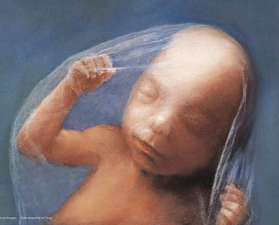
28 Weeks - End of Month 7
“I can look around!”
Thank you for praying for me. I am 7 months old now. I am growing every day. I’m between 14 and 17 inches long and weigh about 41/2 pounds. I move around a lot but it’s getting crowded in here! Sometimes I even get the hiccups!
Guess what your baby can do now…
See
Hear and recognize mom’s voice
Taste
Cough
Yawn
Hiccup
Amazing!!
http://www.archbalt.org/family-life/respect-life/spiritual-adoption/ Information on the developing baby was taken from: Abortion: Questions and Answers, Dr. and Mrs. John C. Wilke, © 1985, Hayes Publishing Company, Inc., Cincinnati, OH. Illustrations(c)L.Brenegan 2001 – may not be reprinted without express permission of the artist.

Slide 9

32 Weeks - End of Month 8
“I like to listen to my Mommy’s voice!”
Thank you for praying for me! I am 8 months old now. I’ve got long fingernails and I’m busy getting ready for my birthday. I can’t wait to see my Mom and Dad. Thanks to you and your prayers, I’ll see them soon.
Now your spiritually adopted baby is finished developing and is concentrating on gaining weight; she might be making her mother uncomfortable with her size (please keep her in your prayers, too!) Your prayers have helped give your spiritually adopted baby’s mother the grace she needed to bring her baby to term.
http://www.archbalt.org/family-life/respect-life/spiritual-adoption/ Information on the developing baby was taken from: Abortion: Questions and Answers, Dr. and Mrs. John C. Wilke, © 1985, Hayes Publishing Company, Inc., Cincinnati, OH. Illustrations(c)L.Brenegan 2001 – may not be reprinted without express permission of the artist.

Slide 10
40 Weeks - End of Month 9
“Here I am!”
It’s my birthday!
Thank you so much for all your prayers! Because you prayed for me, I got the best of all gifts-
Life!
Your spiritually adopted baby was born this month. She is truly a miracle. She began as a 46-chromosome cell and has grown over the past nine months into this unique human baby we can now see and hold in our arms. Never before in history, nor ever again, will anyone exist who is exactly like your spiritually adopted baby.
Thank you for your participation in the Spiritual Adoption program! The time and energy you put into supporting babies and parents in our community by your prayers is greatly appreciated!
http://www.archbalt.org/family-life/respect-life/spiritual-adoption/ Information on the developing baby was taken from: Abortion: Questions and Answers, Dr. and Mrs. John C. Wilke, © 1985, Hayes Publishing Company, Inc., Cincinnati, OH. Illustrations(c)L.Brenegan 2001 – may not be reprinted without express permission of the artist.

